Slide 1
Email Security
email contents are not secure
may be inspected either in transit
or by suitably privileged users on destination system
Notes:
In virtually all distributed environments, electronic mail is the most heavily used network-based application. But current email services are roughly like "postcards”, anyone who wants could pick it up and have a look as its in transit or sitting in the recipients mailbox.

Slide 2
Email Security Enhancements
confidentiality
protection from disclosure
authentication
of sender of message
message integrity
protection from modification
non-repudiation of origin
protection from denial by sender
Notes:
With the explosively growing reliance on electronic mail for every conceivable purpose, there grows a demand for authentication and confidentiality services. What we want is something more akin to standard mail (contents protected inside an envelope) if not registered mail (have confidence about the sender of the mail and its contents). That is, the “classic” security services listed are desired.

Slide 3
Pretty Good Privacy (PGP)
widely used de facto secure email
developed by Phil Zimmermann
selected best crypto algorithms are used to provide: authentication, confidentiality, compression, email compatibility and segmentation
All algorithms are integrated into a single framework
Notes:
The Pretty Good Privacy (PGP) secure email program, is a remarkable phenomenon, has grown explosively and is now widely used. Largely the effort of a single person, Phil Zimmermann, who selected the best available crypto algorithms to use & integrated them into a single program, PGP provides a confidentiality and authentication service that can be used for electronic mail and file storage applications. It runs on a wide range of systems, in both free & commercial versions.

Slide 4
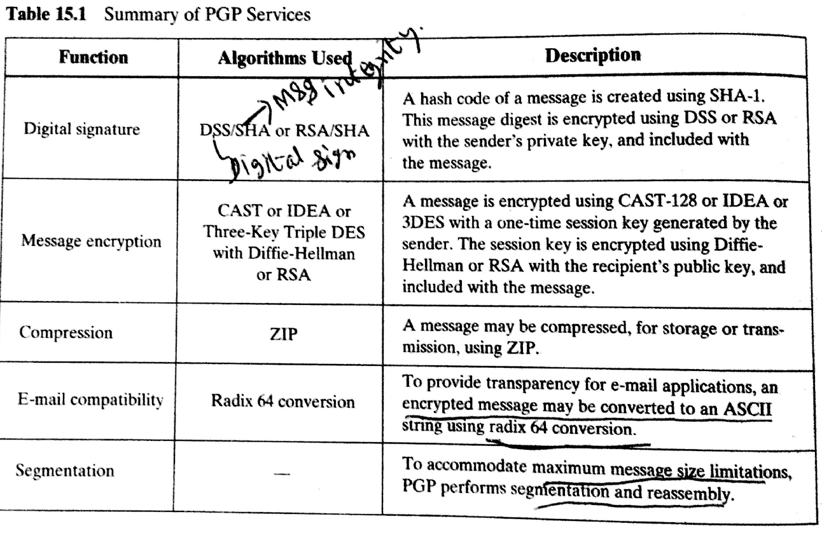

Slide 5
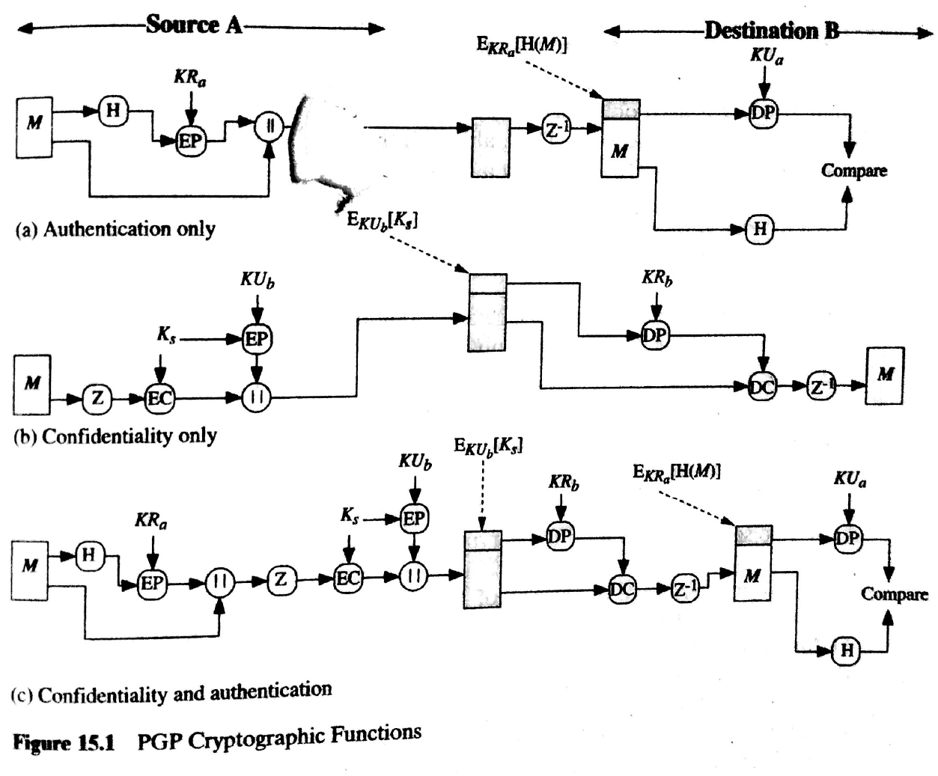

Slide 6
PGP Operation – Authentication
sender creates message
use SHA-1 to generate 160-bit hash of message
signed hash with RSA using sender's private key, and is attached to message
receiver uses RSA with sender's public key to decrypt and recover hash code
receiver verifies received message using hash of it and compares with decrypted hash code
Notes:
The actual operation of PGP consists of five services: authentication, confidentiality, compression, e-mail compatibility, and segmentation.
Here see the digital signature service provided by PGP, using the steps as shown. Note this assumes use of RSA digital signatures, recent PGP versions also support the use of DSS signatures. Signatures can also be detached from a message/file and sent/stored separately.

Slide 7
PGP Operation – Confidentiality
sender generates message and 128-bit random number as session key for it
encrypt message using CAST-128 / IDEA / 3DES in CBC mode with session key
session key is encrypted using RSA with recipient's public key, & attached to msg
receiver uses RSA with private key to decrypt and recover session key
session key is used to decrypt message
Notes:
Another basic service provided by PGP is confidentiality, provided by encrypting messages to be transmitted or to be stored locally as files, using symmetric encryption algorithms CAST-128, IDEA or 3DES in 64-bit cipher feedback (CFB) mode. The randomly chosen session key used for this is sent encrypted using the recipient’s public RSA key. The steps used in this process are as shown. Recent PGP versions also support the use of ElGamal (a Diffie-Hellman variant) for session-key exchange.

Slide 8
PGP Operation – Confidentiality & Authentication
can use both services on same message
create signature & attach to message
encrypt both message & signature
attach RSA/ElGamal encrypted session key
Notes:
Both confidentiality & authentication services may be used for the same message. Firstly a signature is generated for the plaintext message and prepended to the it. Then the plaintext message plus signature is encrypted using CAST-128 (or IDEA or 3DES), and the session key is encrypted using RSA (or ElGamal).

Slide 9
PGP Operation – Compression
by default PGP compresses message after signing but before encrypting
so can store uncompressed message & signature for later verification
& because compression is non deterministic
uses ZIP compression algorithm
Notes:
By default PGP compresses the message after applying the signature but before encryption. This has the benefit of saving space both for e-mail transmission and for file storage. The signature is generated before compression for the reasons shown. The compression algorithm used is ZIP, which is described in Stallings Appendix 15A.

Slide 10
PGP Operation – Email Compatibility
PGP will have binary data ( eg., encrypted message ) to send
however email was designed only for text (ASCII)
hence PGP must encode raw binary data into printable ASCII characters
PGP uses radix-64 algorithm
maps 3 bytes to 4 printable chars
also appends a CRC
PGP also segments message if it is too big
Notes:
When PGP is used, at least part of the block to be transmitted is encrypted, and thus consists of a stream of arbitrary 8-bit octets. However many electronic mail systems only permit the use of ASCII text. To accommodate this restriction, PGP provides the service of converting the raw 8-bit binary stream to a stream of printable ASCII characters. It uses radix-64 conversion, in which each group of three octets of binary data is mapped into four ASCII characters. This format also appends a CRC to detect transmission errors. See Stallings Appendix 15B for a description.
PGP also automatically subdivides a message that is too large for a single email, into segments that are small enough to send.

Slide 11
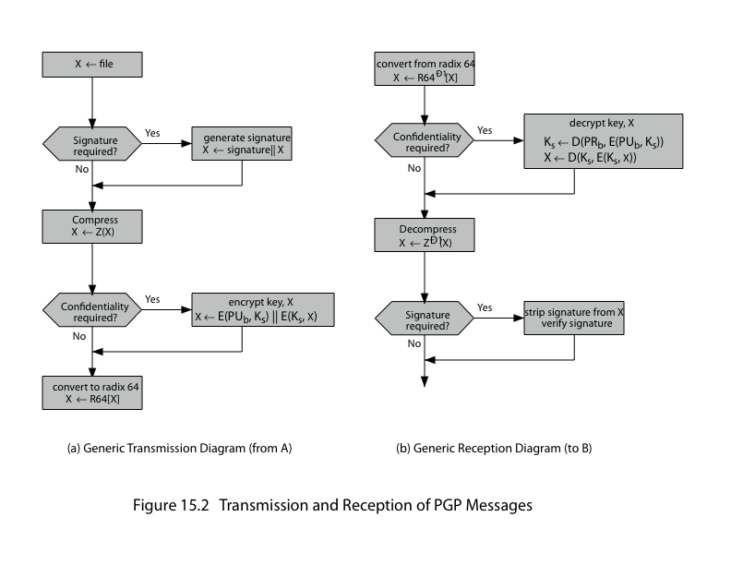
PGP Operation – Summary
Notes:
Stallings Figure 15.2 illustrates the general operation of PGP, and the relationship between the services discussed.

Slide 12
PGP Session Keys
need a session key for each message
of varying sizes: 56-bit DES, 128-bit CAST or IDEA, 168-bit Triple-DES
generated using ANSI X12.17 mode(RNG)
uses random inputs taken from previous uses and from keystroke timing of user
Notes:
PGP makes use of four types of keys: one-time session symmetric keys, public keys, private keys, and passphrase-based symmetric keys.
Each session key is associated with a single message and is used only for the purpose of encrypting and decrypting that message. Random numbers are generated using the ANSI X12.17 generator, with inputs based on keystroke input from the user, where both the keystroke timing and the actual keys struck are used to generate a randomized stream of numbers. Stallings Appendix 15C discusses PGP random number generation techniques in more detail.

Slide 13
PGP Public & Private Keys
since many public/private keys may be in use, need to identify which is actually used to encrypt session key in a message
could send full public-key with every message
but this is inefficient
rather use a key identifier based on key
is least significant 64-bits of the key
will very likely to be unique
also use key ID in signatures
Notes:
Since many public/private keys may be in use with PGP, there is a need to identify which key is actually used to encrypt the session key for any specific message. You could just send the full public-key with every message, but this is inefficient. Rather PGP use a key identifier based on the least significant 64-bits of the key, which will very likely be unique. Then only the much shorter key ID would need to be transmitted with any message. A key ID is also required for the PGP digital signature.

Slide 14
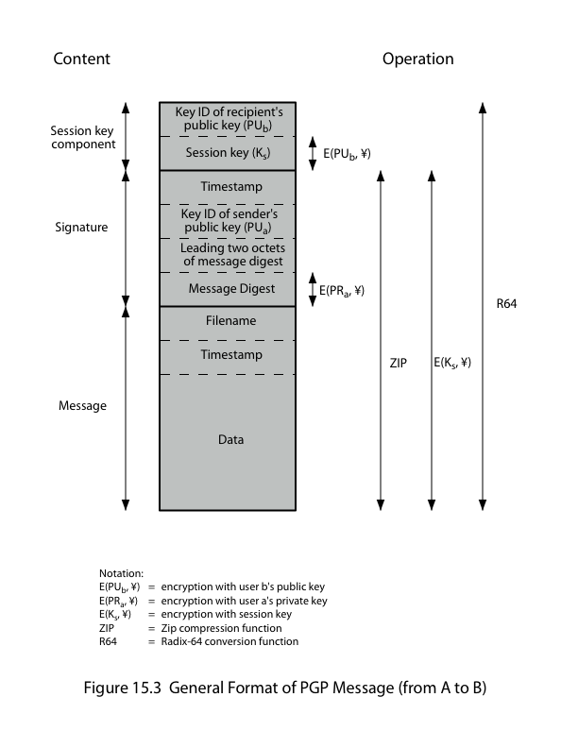
PGP Message Format
Notes:
Stallings Figure 15.3 shows the format of a transmitted PGP message. A message consists of three components: the message component, a signature (optional), and a session key component (optional).

Slide 15
PGP Key Rings
each PGP user has a pair of keyrings:
public-key ring contains all the public-keys of other PGP users known to this user, indexed by key ID
private-key ring contains the public/private key pair(s) for this user, indexed by key ID & encrypted keyed from a hashed passphrase
security of private keys thus depends on the security of pass-phrase
Notes:
Keys & key IDs are critical to the operation of PGP. These keys need to be stored and organized in a systematic way for efficient and effective use by all parties. PGP uses a pair of data structures, one to store the users public/private key pairs - their private-key ring; and one to store the public keys of other known users, their public-key ring. The private keys are kept encrypted using a block cipher, with a key derived by hashing a pass-phrase which the user enters whenever that key needs to be used. As in any system based on passwords, the security of this system depends on the security of the password, which should be not easily guessed but easily remembered.

Slide 16
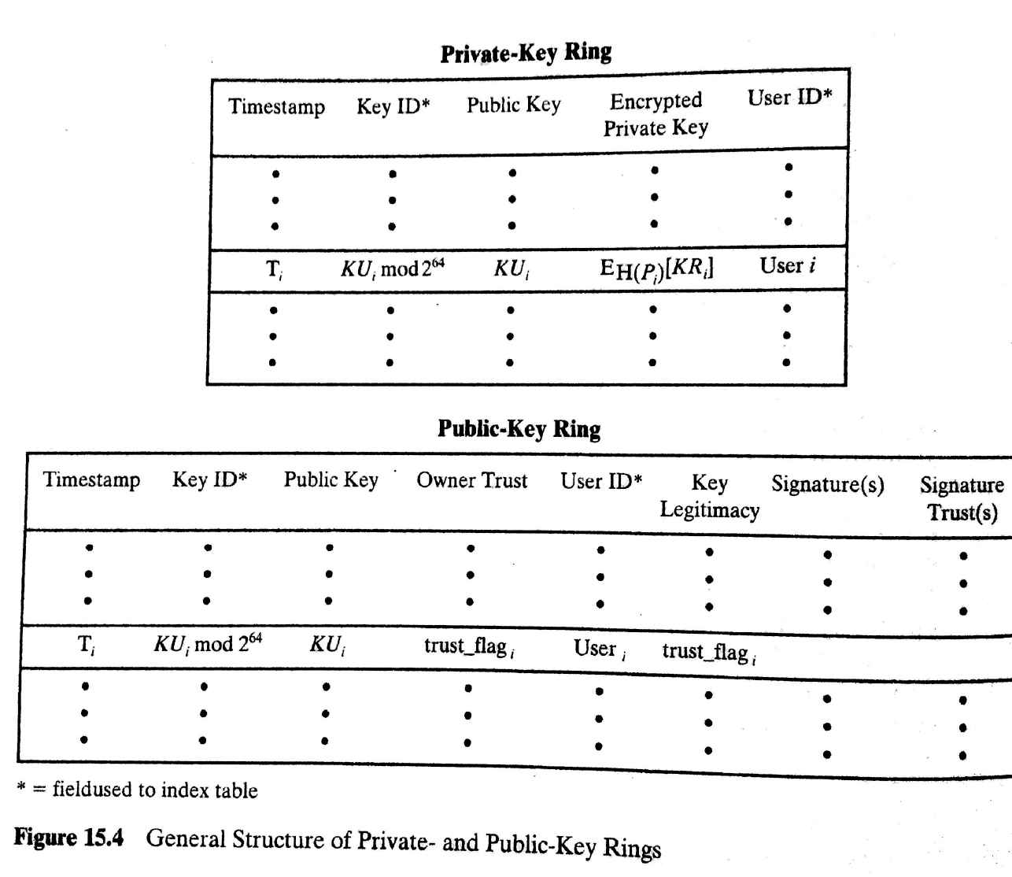

Slide 17
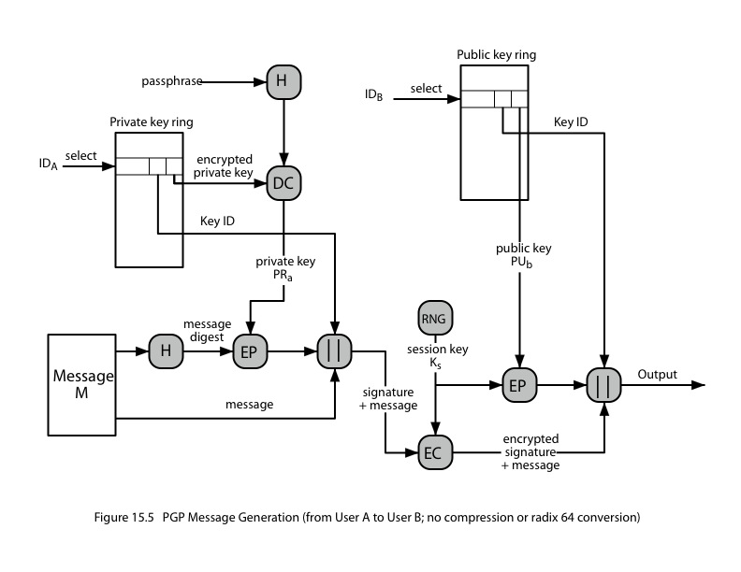
PGP Message Generation
Notes:
Stallings Figure 15.5 illustrates how these key rings are used in message transmission to implement the various PGP crypto services (ignoring compression and radix-64 conversion for simplicity).

Slide 18
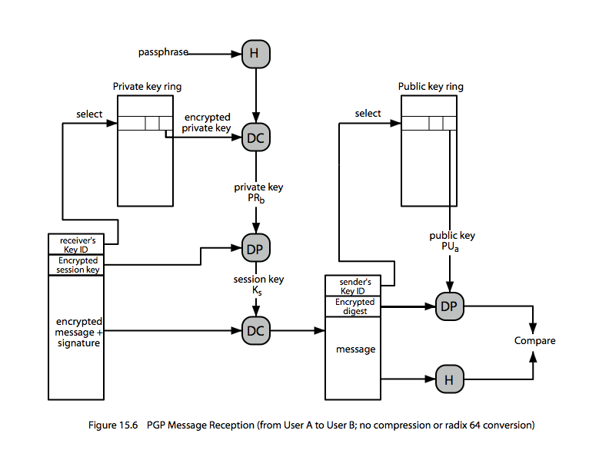
PGP Message Reception
Notes:
Stallings Figure 15.6 then illustrates how these key rings are used in message reception to implement the various PGP crypto services (again ignoring compression and radix-64 conversion for simplicity).

